Slide 1

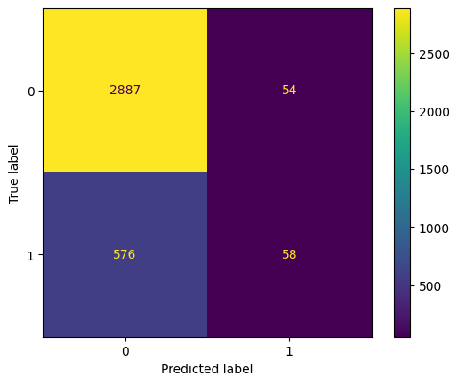
User Churn Project | Regression Modeling Results
Significant Predictor: activity_days was identified as a strong predictor in the model, with a notable coefficient indicating its influence on the log odds of churning.
Engineered Feature Utility: The professional_driver feature, created through feature engineering, showed a noticeable difference in churn rates between the two groups, suggesting its value as a predictor
Engineered Feature Utility: The professional_driver feature, created through feature engineering, showed a noticeable difference in churn rates between the two groups, suggesting its value as a predictor
Prepared for: Waze Leadership Team
The Waze data team is currently developing a data analytics project aimed at increasing overall growth by preventing monthly user churn on the Waze app. For the purposes of this project, churn quantifies the number of users who have uninstalled the Waze app or stopped using the app. Binomial logistic regression models typically offer flexibility and predictive power, which can be used to inform larger business decisions. Our team sought to build one from the data provided for this project. This report offers details and key insights from Milestone 5, which impact the future development of the overall project.
Milestone 5 - Regression Modeling
🎯 Target Goal: Apply user data to build and analyze a binomial logistic regression model.
🎯 Methods:
Created features of interest to the stakeholders and business scenario
Assessed features for multicollinearity
Built the regression model
Evaluated model performance
🎯 Impact: With enough data, binomial logistic regression model results can reveal important variable relationships and predict binary outcomes, which can inform decisions for marketing and product development, for example.
Note: 1 = churned and 0 = retained
Significant Predictor: Activity Days was identified as a strong predictor in the model.
Precision vs. Recall: The model shows better precision than recall, meaning that when it predicts a user will churn, it's more likely to be correct, but it misses a large number of actual churners (false negatives).
. Impact of Data Preparation: Steps like handling missing values, imputing outliers based on the 95th percentile, and addressing multicollinearity by dropping highly correlated features were crucial in preparing the data for modeling
Engineered feature utility: The professional driver feature created through feature engineering, showed a noticeable difference in churn rates between the two groups, suggesting its value as a predictor.
Gather More Data: As mentioned in the previous steps, if there are other data points that could be relevant to user behavior and churn Waze should consider collecting this information for future analysis and model improvement.
Consider the Cost of False Negatives and False Positives: Waze should evaluate the business implications of false negatives versus false positives This evaluation can help inform decisions about how to use the model's predictions and if adjustments are needed to prioritize precision or recall.

